Slide 1
M-F Effect Estimate Comparison
4/12/2022
Weight is proportion of non-null and non female/male only

Slide 2
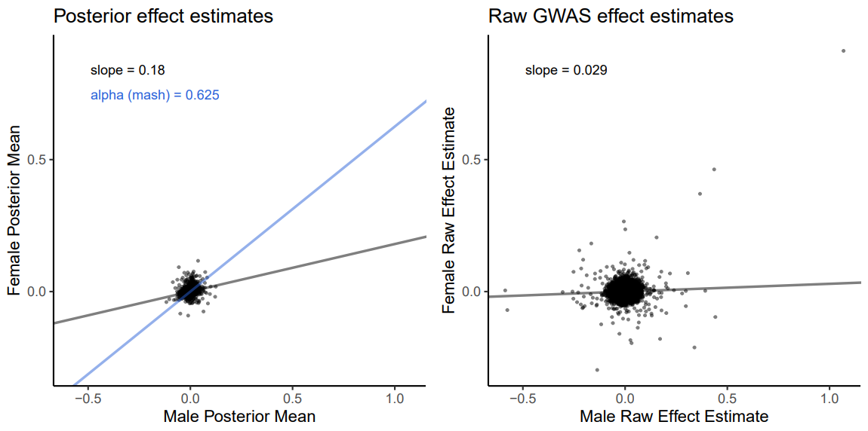
Arm fat-free mass (R)

Slide 3
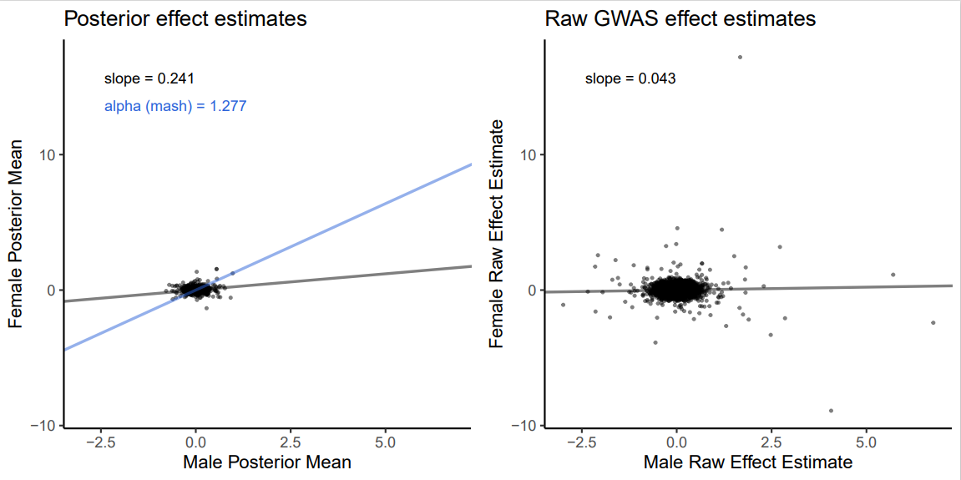
BMI

Slide 4
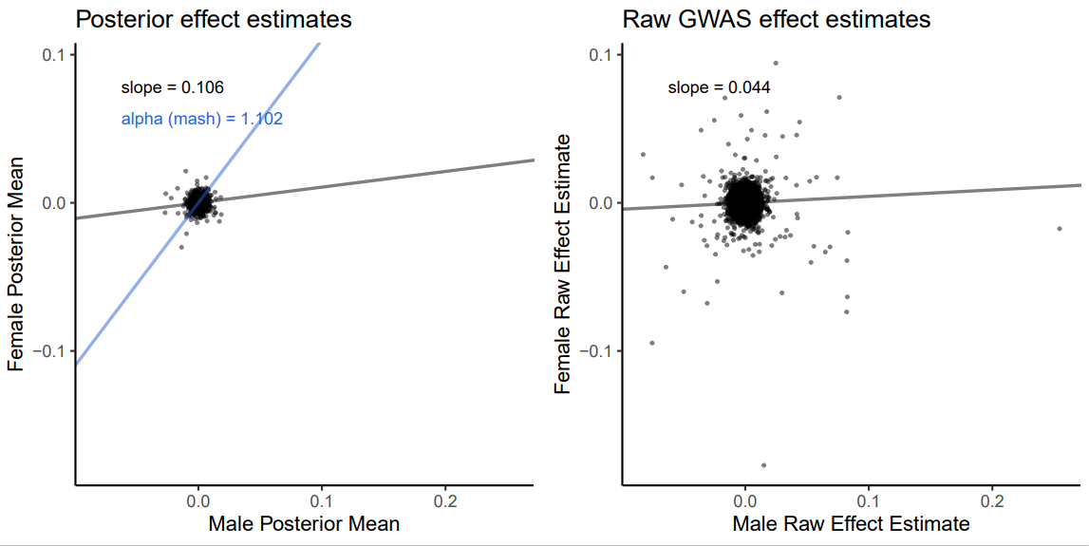
Calcium

Slide 5
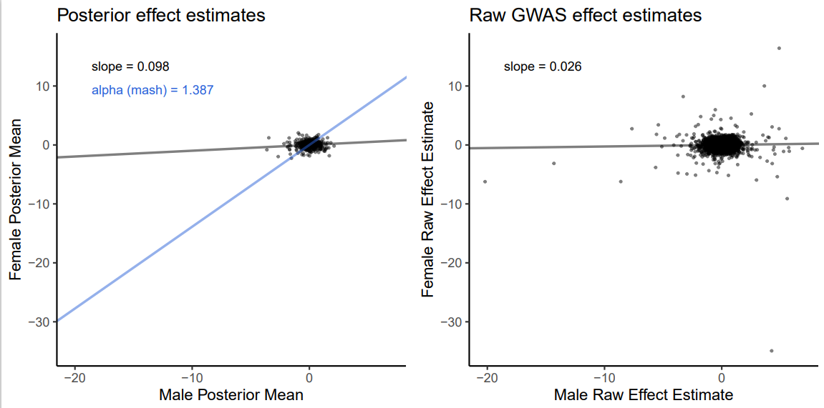
Diastolic BP

Slide 6
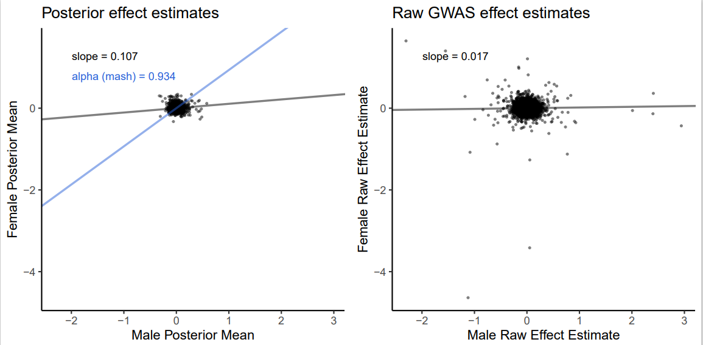
Eosinophil %

Slide 7
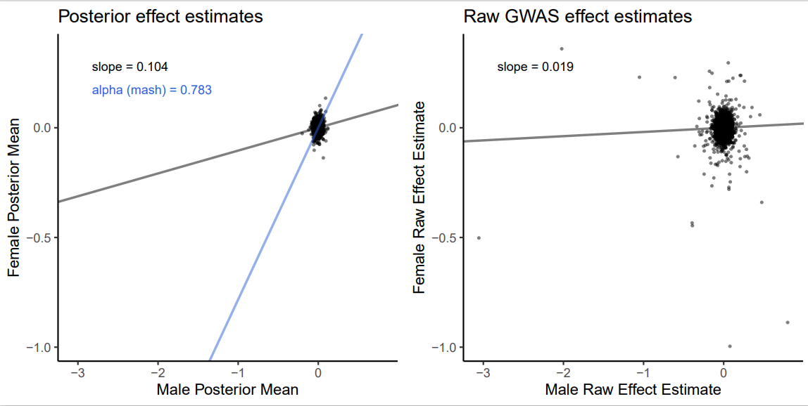
Forced vital capacity

Slide 8
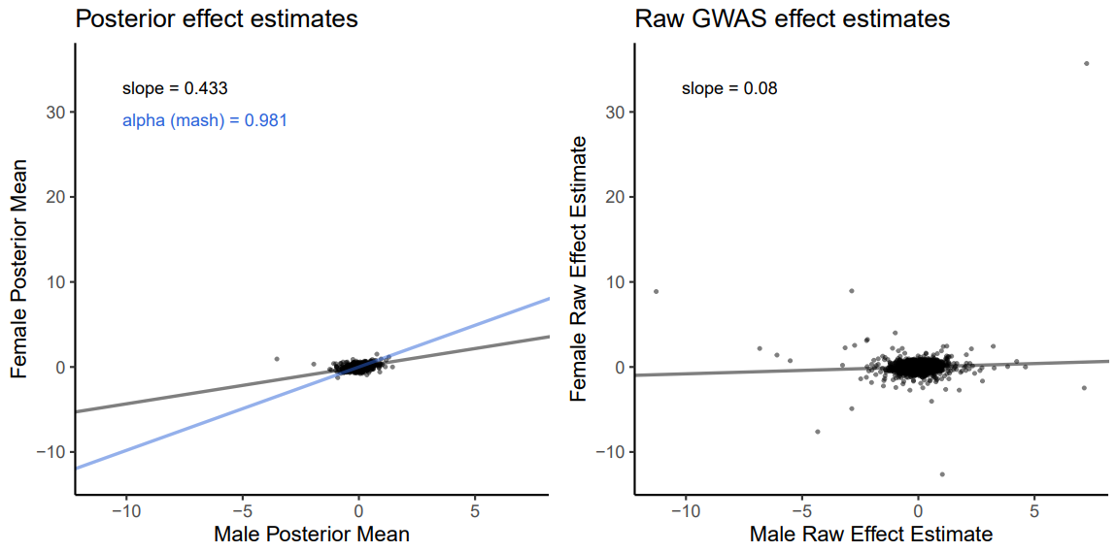
Height

Slide 9
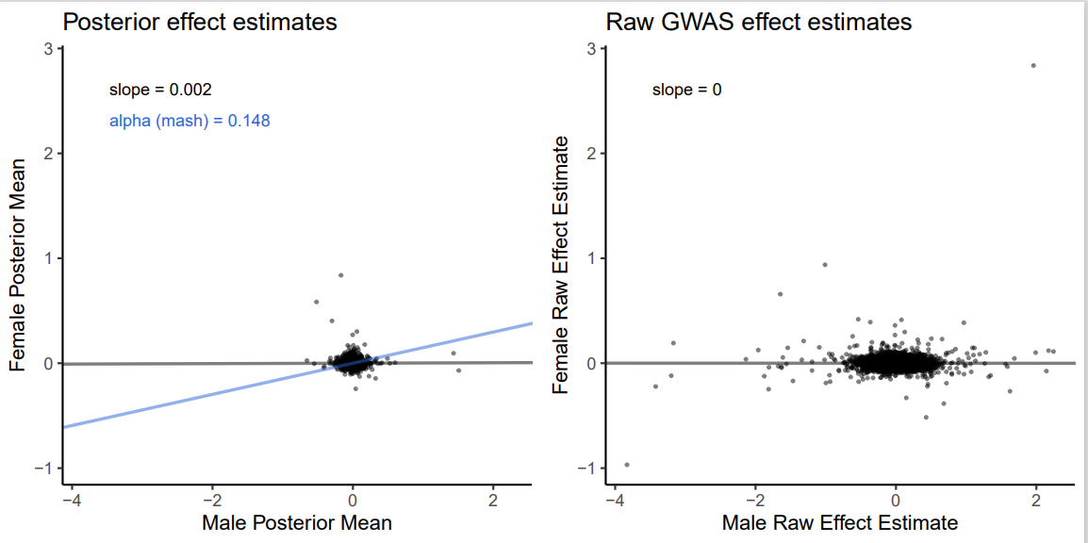
Testosterone

Slide 10
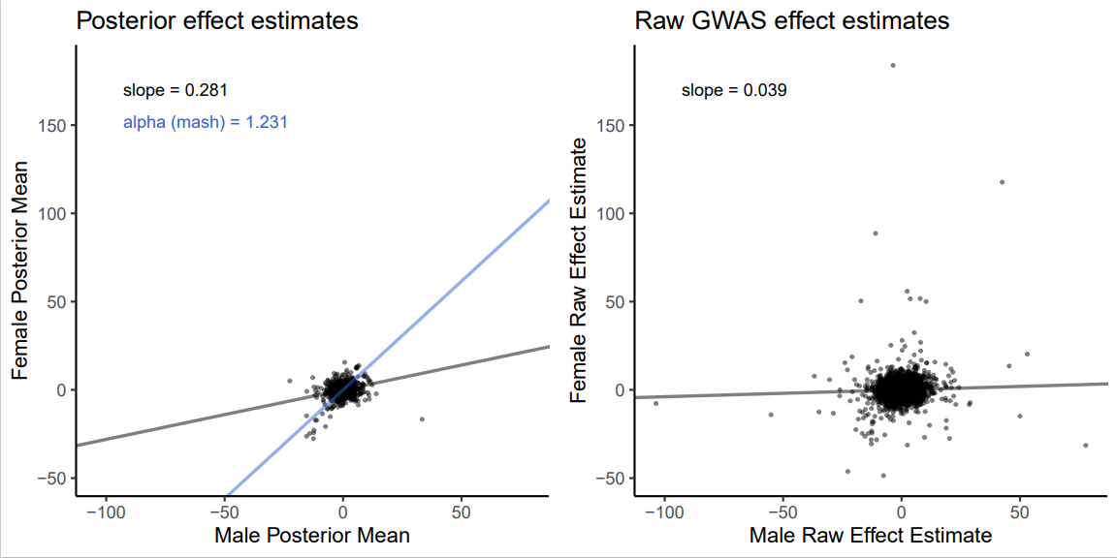
Urate

Slide 11
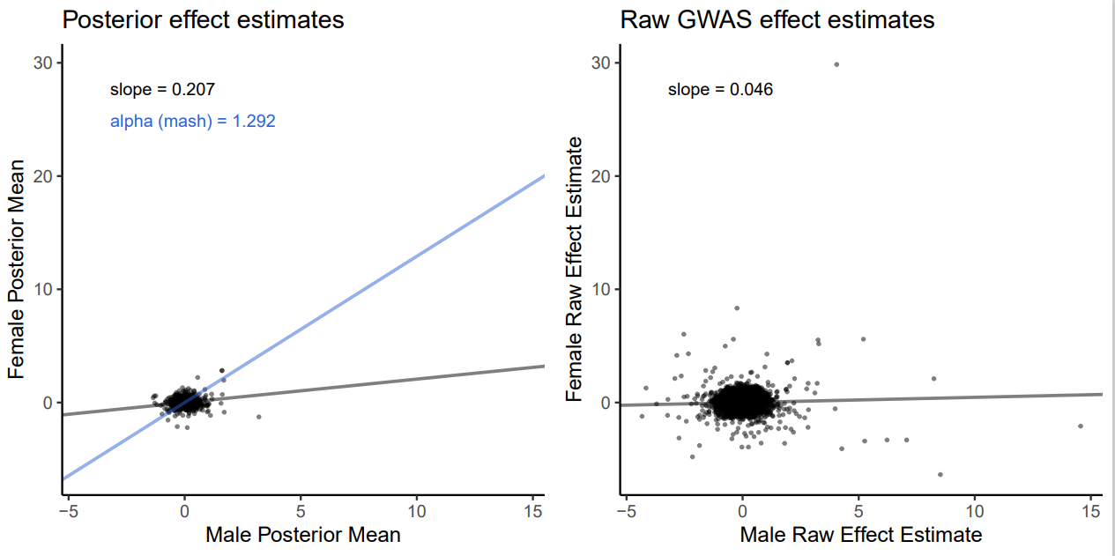
Whole body fat mass

